Slide 1

Travel route suggestion based on pattern of travel and difficulties
Group members:
Supriti Mondal (CSE-DS/2021/015)
Amrita Mondal(CSE-DS/2021/018)
Sanchita Sarkar(CSE-DS/2021/008)
Siddhartha Shaw(CSE-DS/2021/003)
Guided by:
Ms. Manali Sarkar

Slide 2

Agenda
Introduction
Project Architecture
Literature Survey
Project Output
Future Scope
References

Slide 3

INTRODUCTION
Travel route suggestion based on patterns of travel and difficulties is a system approach that recommends travel routes by analyzing both travelers' preferences and the challenges.
The project use traveler experiences as information in guiding future travelers to tell which route will be preferable for them.
The recommender system has an objective to filter unwanted information and to provide specific results for the particular user.
This project is designed to be helpful for everyone, even for those new to recommender systems.

Slide 4
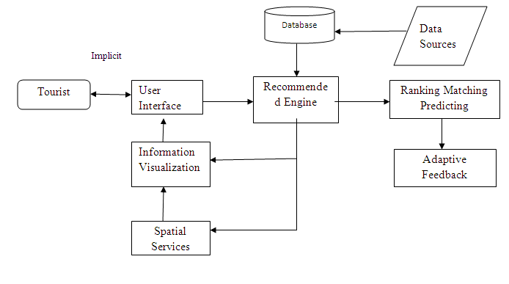
Project architecture

Slide 5
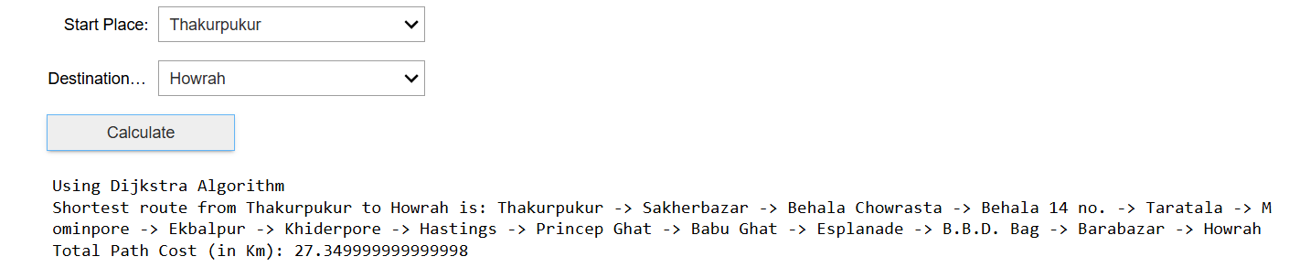
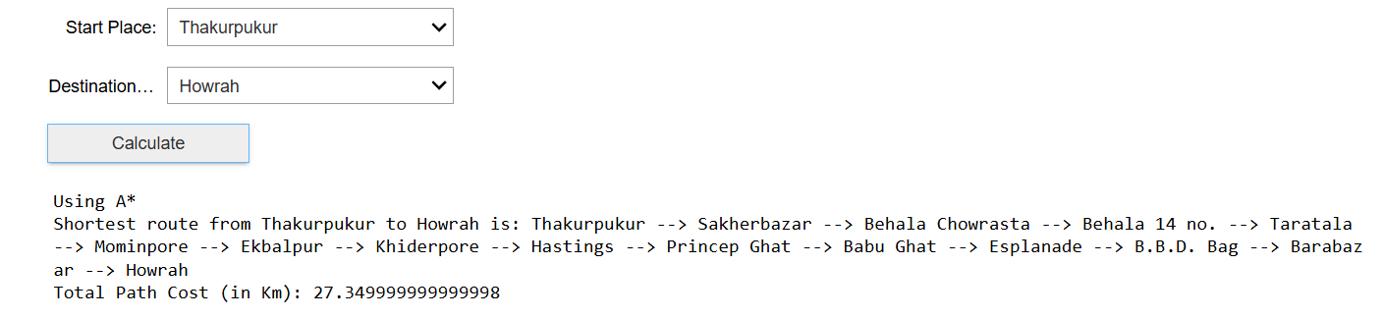
Project output

Slide 6
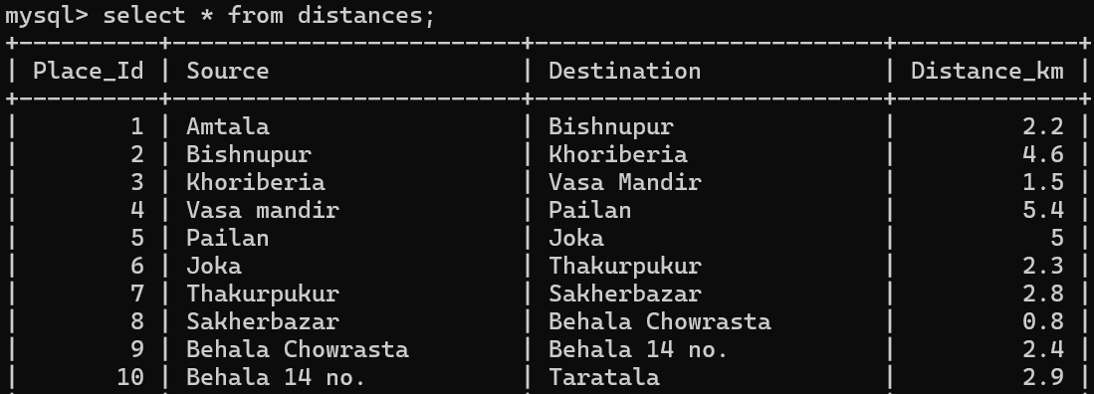
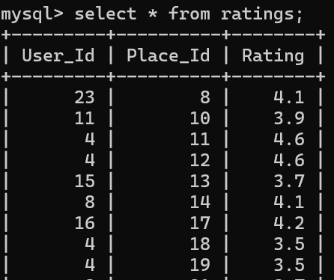
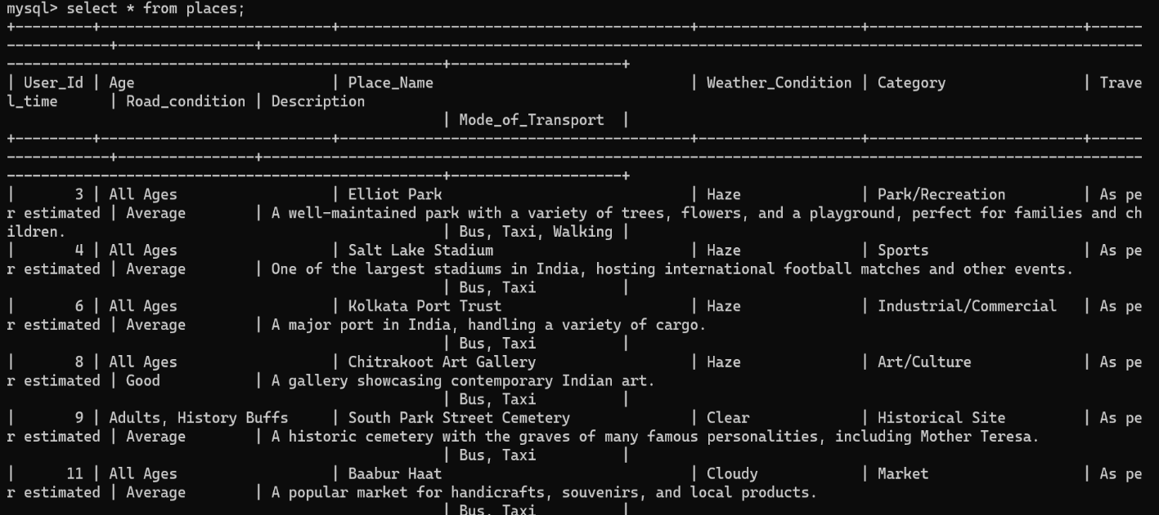
DATABASE

Slide 7
Future scope
This will be a user-friendly, web-based platform that will allow users to easily input their preferences, access personalized recommendations, and find optimal routes.
This system can predict the most likely travel difficulties and suggest alternative routes in advance based on user preferences such as avoiding crowds, minimizing travel time.
It will integrate real-time data sources, such as traffic conditions, weather updates, and road conditions, and continuously improve by adjusting recommendations based on user satisfaction.
Together, these will make the travel recommendation system more accessible for modern travelers, enhancing travel planning to be more accurate, efficient, and enjoyable.

Slide 8
Reference
[1] T. Kurashima, T. Iwata, G. Irie, and K. Fujimura, "Travel route recommendation using geotags in photo sharing sites," in Proceedings of the 19th ACM Conference on Information and Knowledge Management (CIKM 2010), Toronto, Ontario, Canada, October 26-30, 2010. DOI: 10.1145/1871437.1871513.
[2] S.Y. Yuliani, Rozahi, and E.A. Laksana, "Dijkstra’s Algorithm to Find Shortest Path of Tourist Destination in Bandung," Informatic Engineering, Widyatama University, vol. 12, pp. 1163–1168, 2021.
[3] G. Cui, J. Luo, and X. Wang, "Personalized travel route recommendation using collaborative filtering based on GPS trajectories," International Journal of Digital Earth, vol. 11, no. 12, pp. 1-24, May 2017. DOI: 10.1080/17538947.2017.1326535.

Slide 9

Thank y☺u!

Slide 10
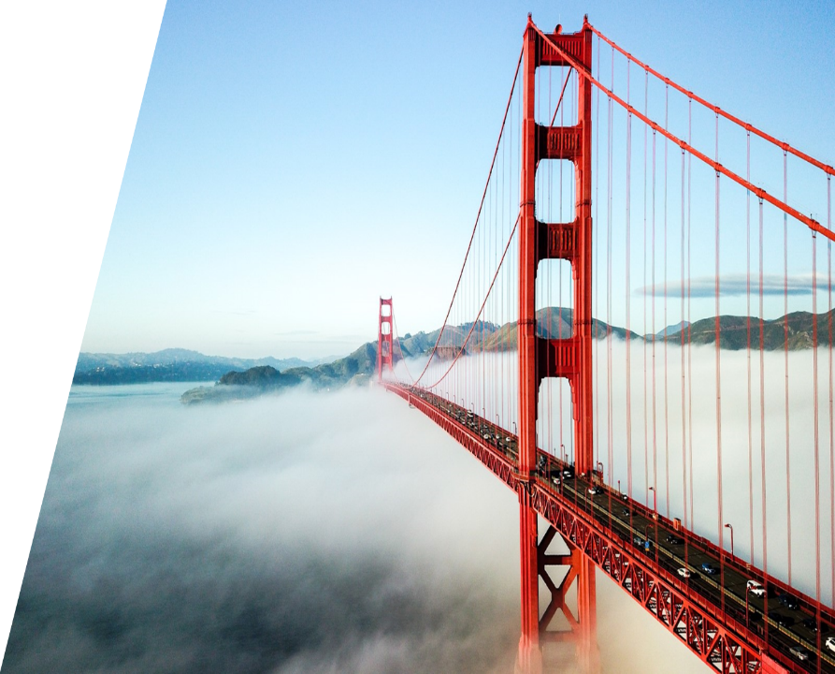
ANY Questions?

